Slide 1

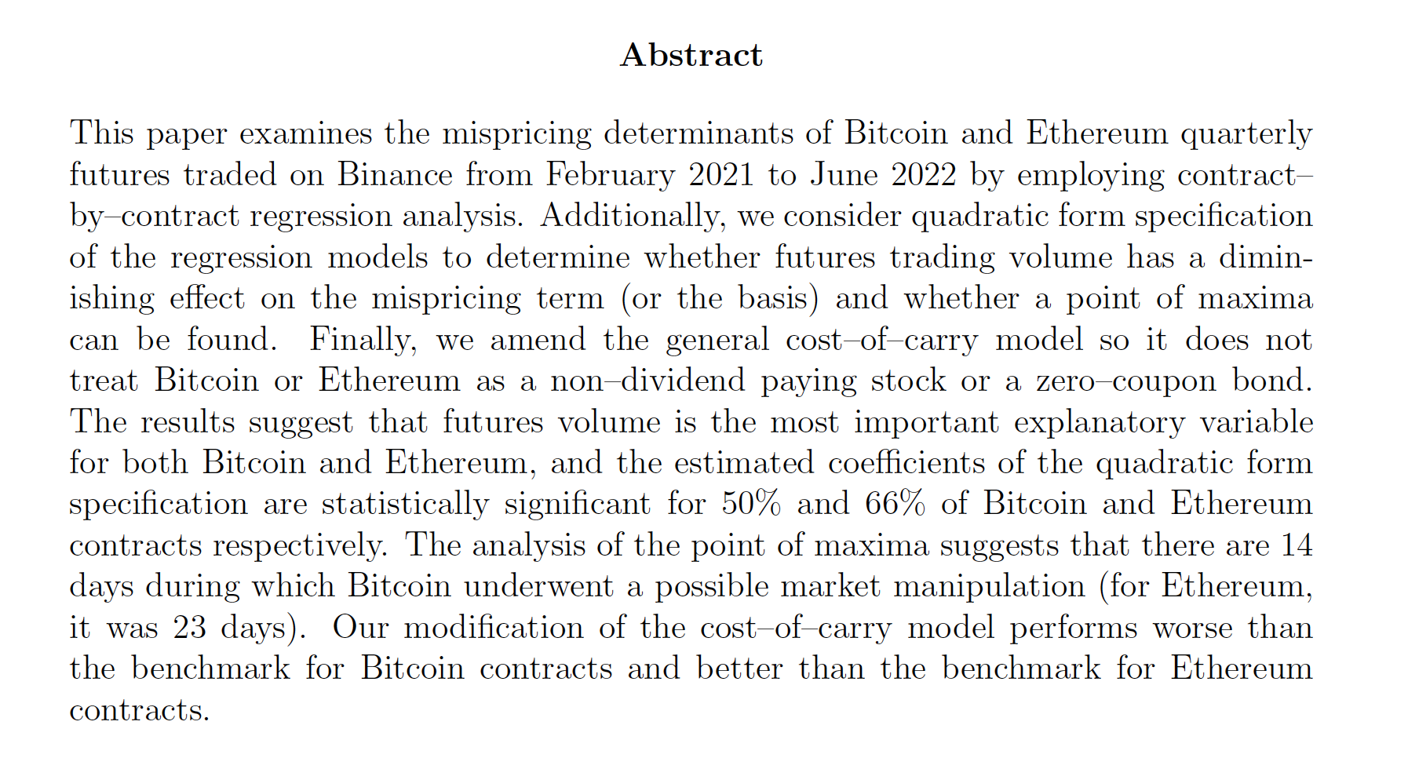
Determinants of Mispricing of Cryptocurrency Futures
Author:
Daniel Pelnar
Supervisor:
Dr Paul A. Bilokon
Second marker:
Prof William J. Knottenbelt
Notes:
I prepared a presentation about the determinants of mispricing of Bitcoin and Ethereum futures traded on Binance
Throughout the presentation, references and citations are highlighted in orange.

Slide 2
Outline
Motivation
Past Research
Objectives and aims (summary)
Contribution (summary)
Data
Cross-sectional vs time-series regressions
Refresher on OLS
General model and contract-by-contract analysis
Quadratic term specification
Results and evaluation
Demonstration
Q&A
Notes:
The first four bullet points are a summary of what the paper was all about.
The next 6 bullet points are selected topics which I want to highlight
The last two are live demonstration and Q&A

Slide 3
Motivation
Adding to the understanding of the dynamics of cryptocurrency futures is important to various entities:
a retail trader trying to leverage their positions
an arbitrageur trying to make riskless profit, and, in the process, induce market efficiency
portfolio manager trying to hedge positions
a regulator trying to protect investors
a central banker trying to maintain price stability (e.g., FED via various banks – manipulation of gold²²)
anyone trying to preserve purchasing power*
[22] Roberts PC, Kranzler D. The hows and whys of gold price manipulation. Institute
for Political Economy. 2014.
Notes:
* not trading futures, but understanding how trading volume influences the spot price and that high trading volume (and short-term decrease in price) might be a sign of market manipulation by larger entities that are not profit maximizing.

Slide 4
Past research
These are the main studies which this paper builds on (and gets an inspiration from):
[21] Matsui T, Al-Ali A, Knottenbelt WJ. On the Dynamics of Solid, Liquid and Digital Gold Futures. arXiv preprint arXiv:220209845. 2022.
  contract by contract analysis; determinants of basis (Bitcoin futures on CME from Dec 2017 to Nov 2022); daily
[1] Hattori T, Ishida R. The relationship between arbitrage in futures and spot markets and Bitcoin price movements: Evidence from the Bitcoin markets. The journal of futures markets. 2021;41(1):105-14.
  determinants of mispricing of Bitcoin futures; intraday data from CBOE and daily data from CME
[2] De Blasis R, Webb A. Arbitrage, contract design, and market structure in Bitcoin futures markets. Journal of Futures Markets. 2022;42(3):492-524.
  determinants of mispricing of Bitcoin futures; daily data from Binance (2 contracts)
[13] Lee S, Meslmani NE, Switzer LN. Pricing Efficiency and Arbitrage in the Bitcoin Spot and Futures Markets. Research in international business and finance. 2020;53:101200.
  determinants of mispricing of Bitcoin futures; daily data from CME; explanatory vars: the issuance of alternative cryptocurrencies, Bitcoin thefts; daily data from CME.
For more, see chapter 1: Literature Review (pages: 4-11).
Notes:
The studies on this slide have multiple research questions, however, I will just be highlighting the research they have done relevant to my paper.
Note that I will talk in same terminology, which differs in some of these papers.

Slide 5
Objectives and aims (summary)
To examine the determining factors of mispricing of Bitcoin and Ethereum quarterly futures traded on Binance from February 2021 to June 2022 (all available data; 6 contracts each) by performing contract–by–contract regression analysis.
To run regressions with futures volume as quadratic term to find out whether a diminishing effect and turning point exist.
To hypothesize that the estimated coefficients of the quadratic regression turns out to be positive for the linear term and negative for the quadratic term (concave function with a point of maxima), indicating a possible manipulation taking place on days whose futures volume exceeds the point of maxima.
To alter the general cost–of–carry model by considering innate cryptocurrency–specific characteristics that reflect the cost associated with carrying (being long) spot.

Slide 6
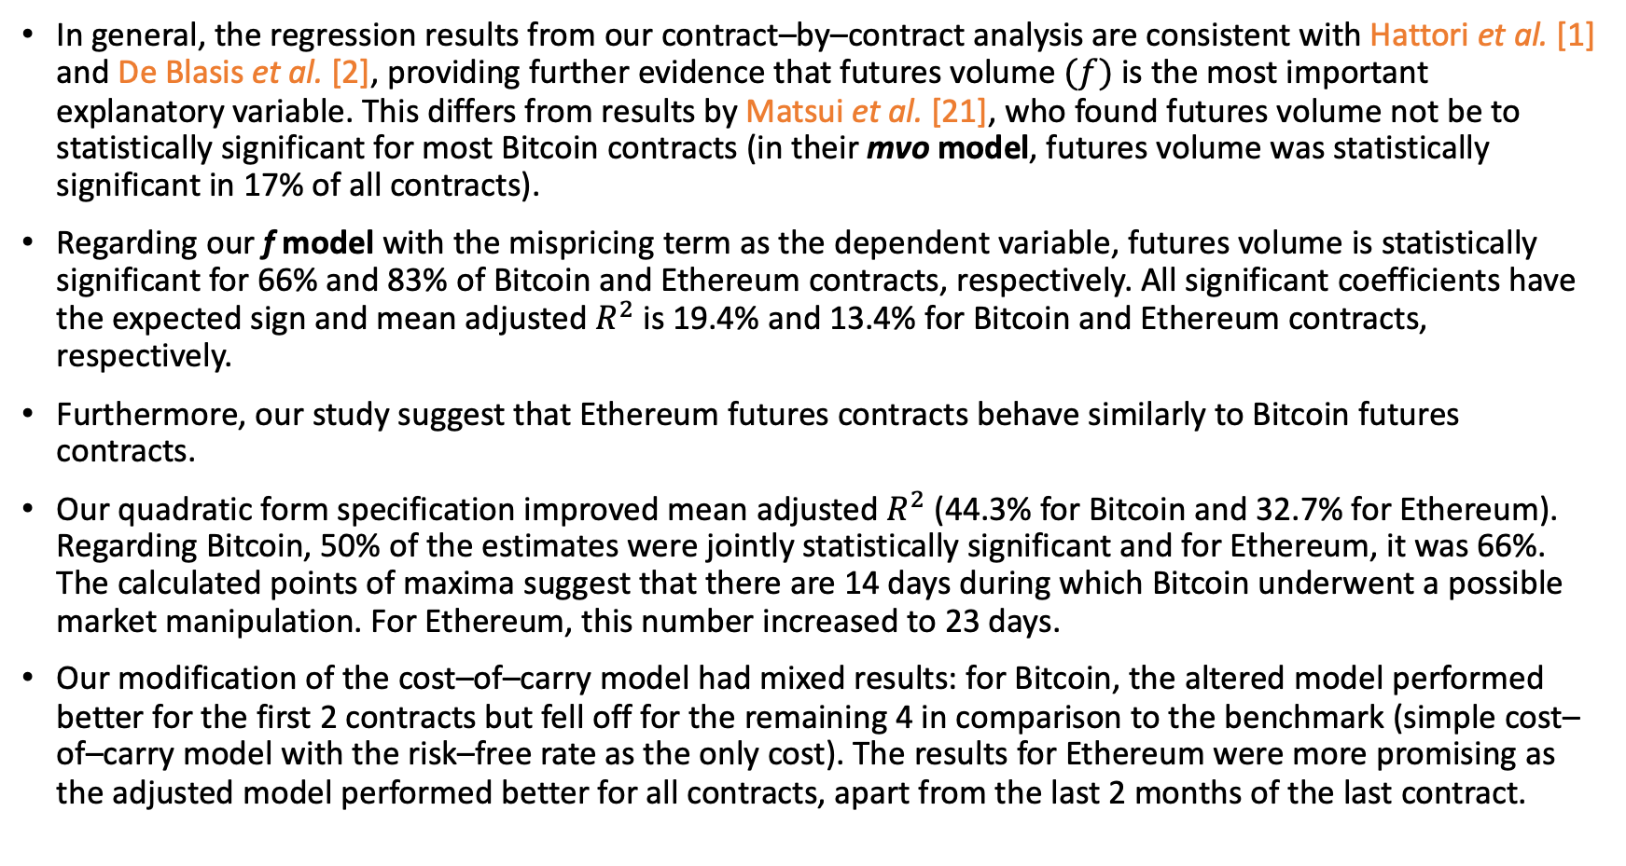
Contribution (summary)
In general, the regression results from our contract–by–contract analysis are consistent with Hattori et al. [1] and De Blasis et al. [2], providing further evidence that futures volume $(f)$ is the most important explanatory variable. This differs from results by Matsui et al. [21], who found futures volume not be to statistically significant for most Bitcoin contracts (in their mvo model, futures volume was statistically significant in 17% of all contracts).
Regarding our f model with the mispricing term as the dependent variable, futures volume is statistically significant for 66% and 83% of Bitcoin and Ethereum contracts, respectively. All significant coefficients have the expected sign and mean adjusted $R^{2}$ is 19.4% and 13.4% for Bitcoin and Ethereum contracts, respectively.
Furthermore, our study suggest that Ethereum futures contracts behave similarly to Bitcoin futures contracts.
Our quadratic form specification improved mean adjusted $R^{2}$ (44.3% for Bitcoin and 32.7% for Ethereum). Regarding Bitcoin, 50% of the estimates were jointly statistically significant and for Ethereum, it was 66%. The calculated points of maxima suggest that there are 14 days during which Bitcoin underwent a possible market manipulation. For Ethereum, this number increased to 23 days.
Our modification of the cost–of–carry model had mixed results: for Bitcoin, the altered model performed better for the first 2 contracts but fell off for the remaining 4 in comparison to the benchmark (simple cost–of–carry model with the risk–free rate as the only cost). The results for Ethereum were more promising as the adjusted model performed better for all contracts, apart from the last 2 months of the last contract.

Slide 7
Data
data sources: Binance, FRED, Messari, and Crystal Blockchain
The outcome is 12 datasets—representing each contract (6 Bitcoin and 6 Ethereum contracts)—covering a period February 2021 to June 2022 and containing 15 variables (although most of which not utilized for the contract–by–contract analysis).

Slide 8
Data: Binance
Most of the required data were queried via the Binance public API. The only time-series of interest that can’t be obtained through the API is insurance fund balance, which had to be downloaded manually.
Variables obtained:
  futures close (BTC and ETH); daily; each contract
  futures volume (BTC and ETH); daily; each contract
  price index (BTC and ETH); daily; each contract
  spot volume (BTC and ETH); daily; each contract
  insurance fund balance (USDT, BUSD); daily; time-series
Variables derived:
  theoretical futures price (BTC and ETH); daily; each contract
  mispricing term (BTC and ETH); daily; each contract
  basis (BTC and ETH); daily; each contract

Slide 9
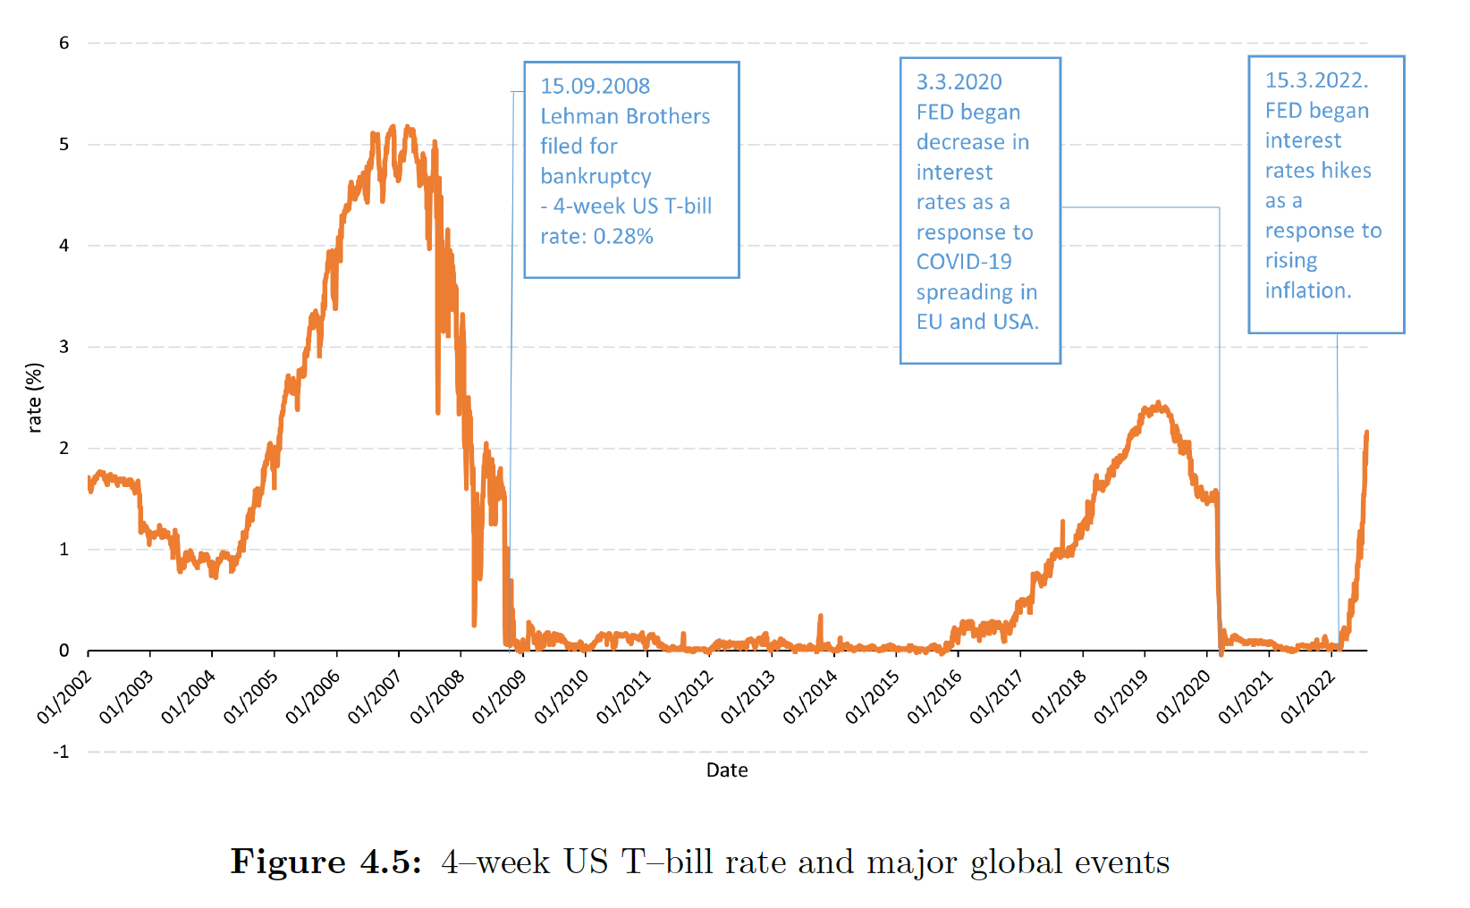
Data: FRED
From Federal Reserve Economic Datasets.
Variables obtained:
  4–week US T–bill rate; daily; time series
  3–month US T–bill rate; daily; time series

Slide 10
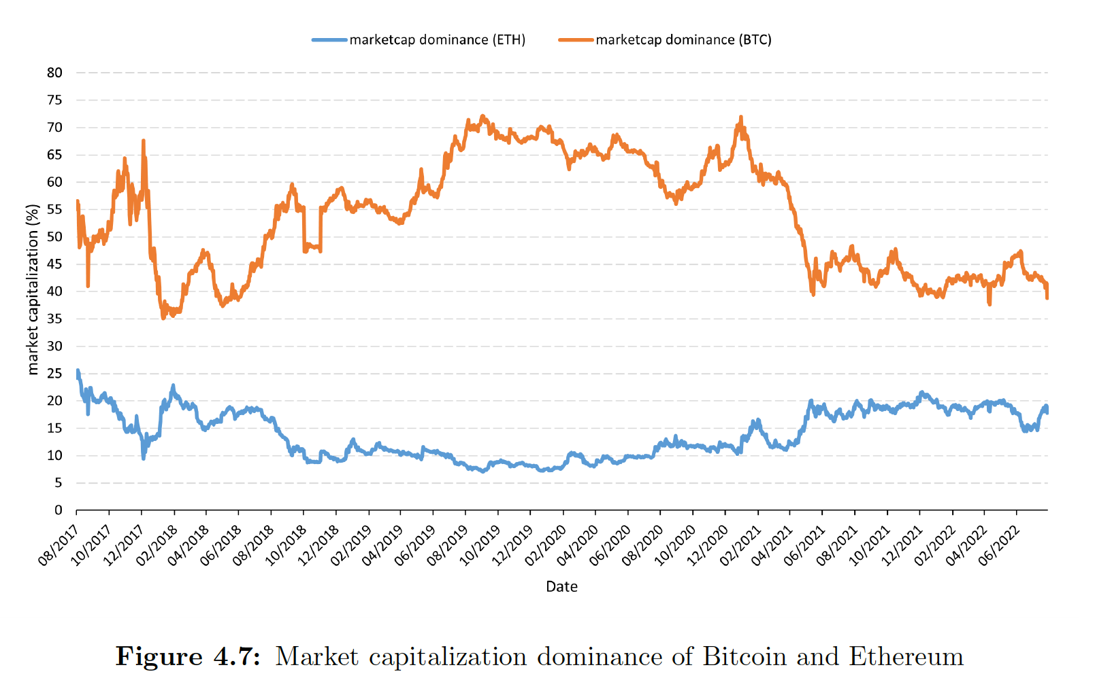
Data: Messari
Data obtained from Messari, a cryptocurrency research, data and tools company.
Variables obtained:
  Marketcap dominance (BTC and ETH); daily; each contract
  Outstanding supply (BTC and ETH); daily; each contract
  Five-year active supply (BTC and ETH); daily; each contract
Variables derived:
  lost coins proxy (BTC and ETH); daily; each contract

Slide 11
Data: Crystal Blockchain
Data obtained by scrapping a report conducted by Crystal Blockchain.
Variables obtained:
  Scam fraud breach; daily; each contract; dummy variable
Notes:
The outcome was a collection of 364 dates where an incident occurred, and a creation of a time-series dummy variable.

Slide 12
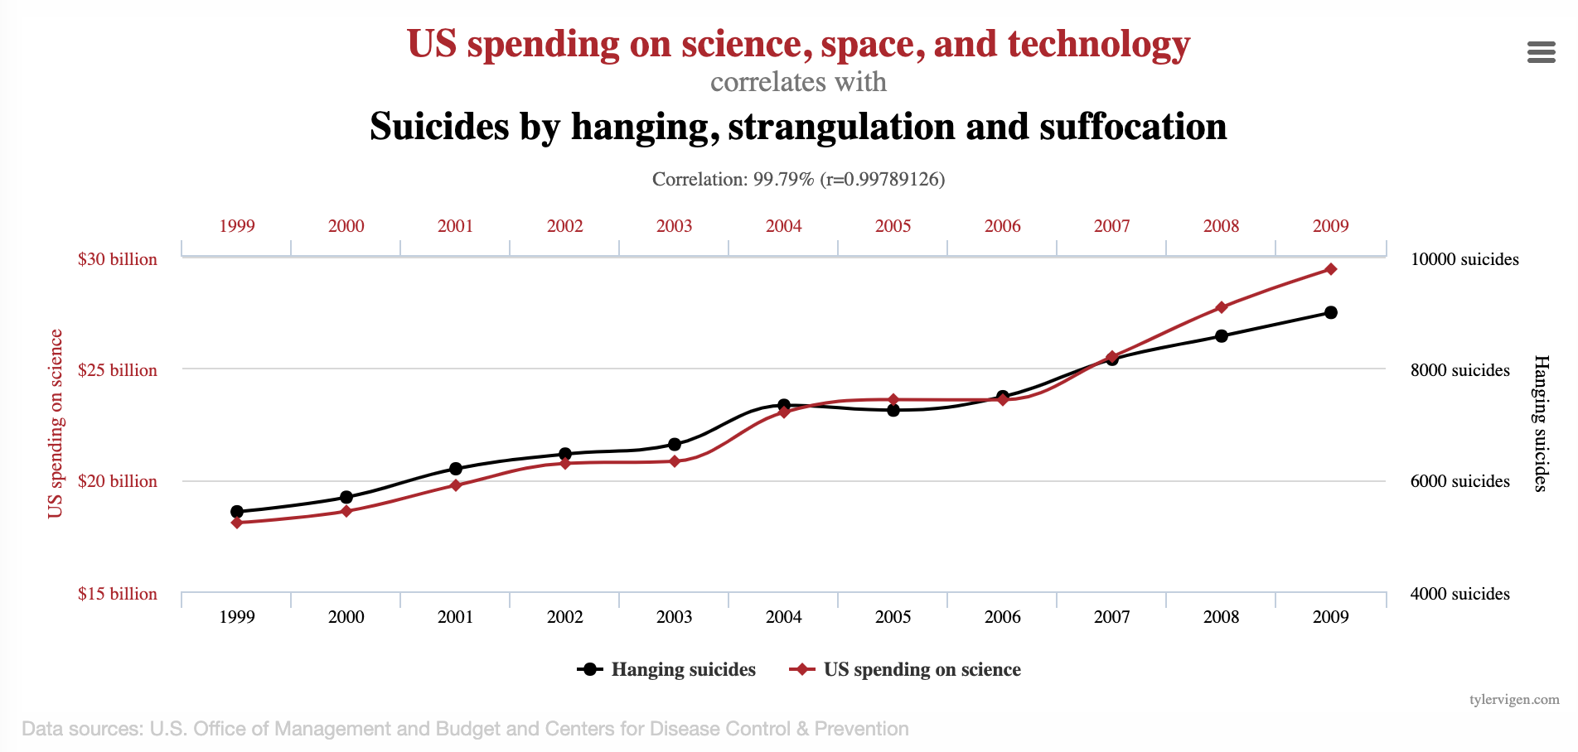
Spurious regressions
source: https://www.tylervigen.com/spurious-correlations
Notes:
This slide provides some motivation of why we need to be careful when running OLS regressions with time series variables.
Figure shows two non-stationary variables. The correlation between them (R^2) is 99.79%. Is inference possible? Is forecasting possible?

Slide 13

Cross sectional vs time series regressions
Bottom line: we need to test all variables to determine if they are stationary (Augmented Dickey–Fuller (ADF) test or Phillips–Perron (PP) test).
After that, we run the regressions, calculate HAC standard errors and corresponding p–values.
  Newey–West heteroscedasticity and autocorrelation consistent (HAC) standard errors [79] with number of lags equal to $T^{\frac{1}{4}}$ as suggested by Greene [80].
More information in chapter 5: Methodology, section 5.1: Cross–sectional vs time–series regressions

Slide 14
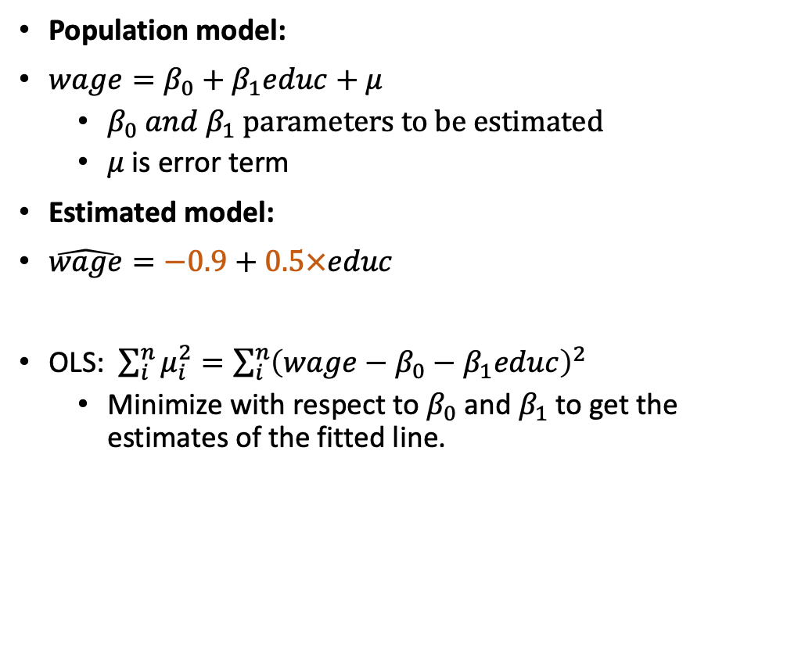
Refresher on OLS
Population model:
$wage=β_{0}+β_{1}educ+μ$
  $β_{0} and β_{1} parameters to be estimated$
  $μ$ is error term
Estimated model:
$\hat{wage}=−0.9+0.5×educ$
OLS: $\sum_{i}^{n}{μ_{i}^{2}}=\sum_{i}^{n}{{\left(wage−β_{0}−β_{1}educ\right)}^{2}}$
  Minimize with respect to $β_{0}$ and $β_{1}$ to get the estimates of the fitted line.
Data source: Wooldridge JM. Introductory econometrics : a modern approach. 6th ed. Australia:
Cengage Learning; 2016 - 2016.
Graphs and example source: My presentation for EY/UCL colab. during 2019 internship
Notes:
- Unrelated example to provide some intuition.

Slide 15
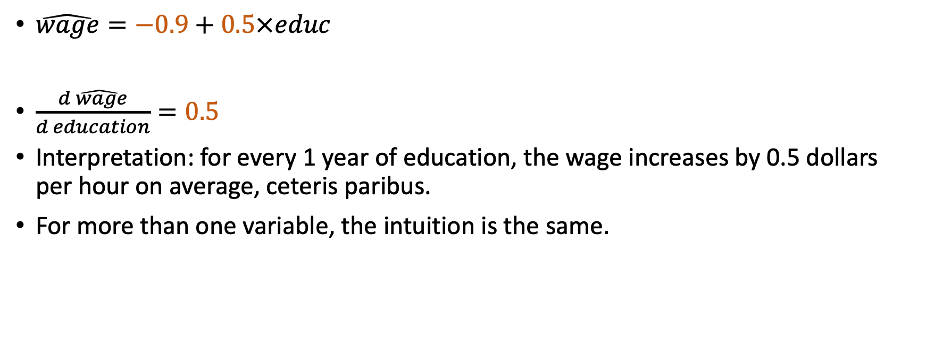
Refresher on interpretation
$\hat{wage}=−0.9+0.5×educ$
$\frac{d\hat{ wage}}{d education}=0.5$
Interpretation: for every 1 year of education, the wage increases by 0.5 dollars per hour on average, ceteris paribus.
For more than one variable, the intuition is the same.
Data source: Wooldridge JM. Introductory econometrics : a modern approach. 6th ed. Australia:
Cengage Learning; 2016 - 2016.
Graphs and example source: My presentation for EY/UCL colab. during 2019 internship

Slide 16
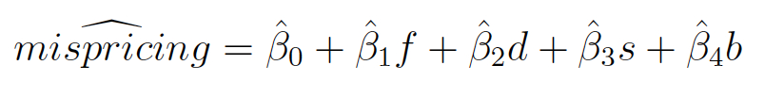
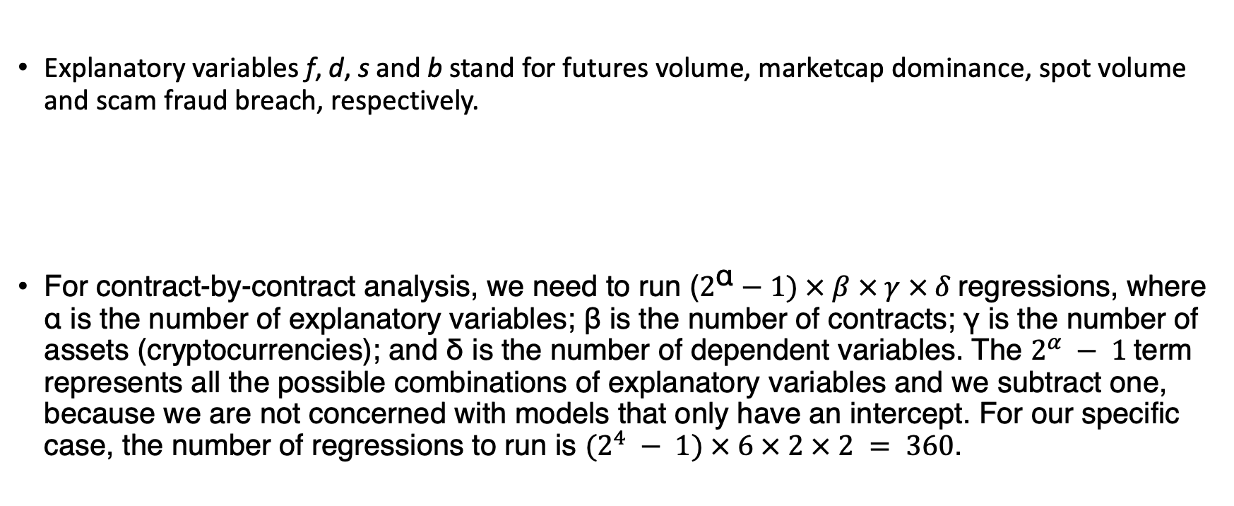
General model and contract-by-contract analysis
Explanatory variables f, d, s and b stand for futures volume, marketcap dominance, spot volume and scam fraud breach, respectively.
For contract-by-contract analysis, we need to run ($2^{\text{α}}−1) × β × γ × δ$regressions, where α is the number of explanatory variables; β is the number of contracts; γ is the number of assets (cryptocurrencies); and δ is the number of dependent variables. The $2^{α} − 1$term represents all the possible combinations of explanatory variables and we subtract one, because we are not concerned with models that only have an intercept. For our specific case, the number of regressions to run is $(2^{4} − 1) × 6 × 2 × 2 = 360$.
Notes:
Mispricing is the dependent variable defined as mispricing term. Note that basis will also be used as a dependent variable.
β0, β1, β2, β3 and β4 are the population slopes and the intercept that we want to estimate.
Explanatory variables f, d, s and b stand for futures volume, marketcap dominance, spot volume and scam fraud breach, respectively.
For scaling purposes, f was divided by a factor of 100 for Bitcoin contracts and by a factor of 10,000 for Ethereum contract. s was divided by a factor of 10,000 for Bitcoin

Slide 17

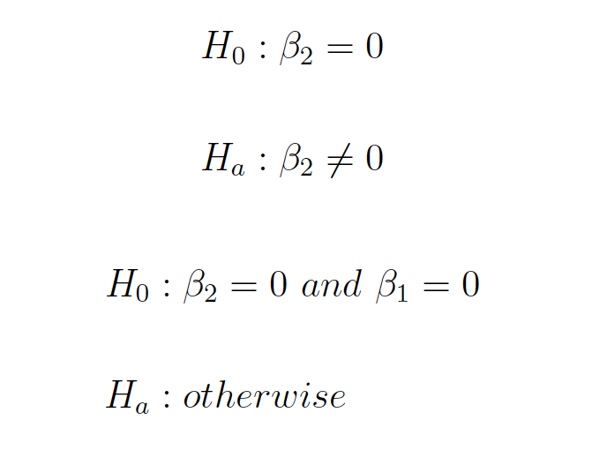
Quadratic term specification
Regression model:
Two hypotheses:
  Does futures volume have a diminishing effect on the mispricing term (and the basis) and whether the point of maxima is present.
Empirically tested by::
Notes:
It’s a nice sunny day in London, almost 41◦ Celsius and we (the author) have a freezer
stacked with chocolate cornettos. Despite being allergic to chocolate, we swallow the
first one and our satisfaction goes through the roof. As the freezer is being emptied,
we notice that although the happiness of gobbling up each new cornetto is still there,
it’s somehow diminishing, becoming less grandiose. Fifth, sixth, seventh, eighth cornetto
down the throat and the allergy has kicked in. No more satisfaction from eating
cornettos, only suffering.
This experience of extreme weather conditions during summer 2022, inspired us to
hypothesize about a possibility of futures volume having a diminishing effect on the
mispricing term (or the basis), and whether the point of maxima can be reached for
some of our observations.
We determine whether we reject each null hypothesis by performing t–test on 5.8 and
joint F–test on 5.9. Should the null hypothesis of 5.8 be rejected at 5% significance
level or lower, we test the joint significance of both coefficients. If we also reject the
second null hypothesis, we conclude an existence of a quadratic relationship.

Slide 18
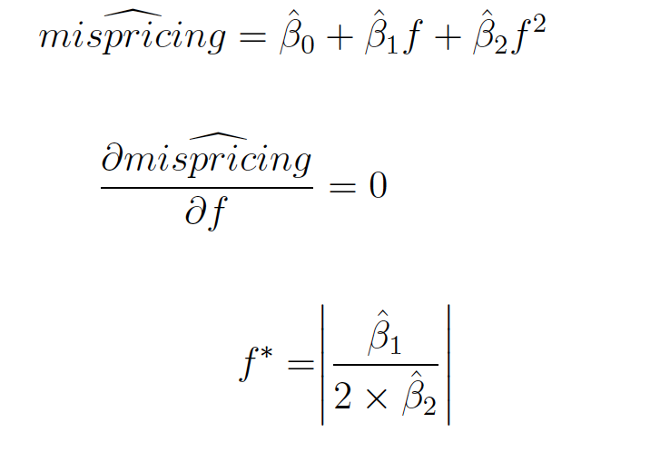

Quadratic term specification (continues)
Moreover, if we observe: ${\hat{β}}_{1} > 0$and ${\hat{β}}_{2}< 0$, the relationship can be modeled as a concave function where the point of maxima, $f^{∗}$, can be computed according to:

Slide 19
Rational behind the quadratic form
Any day whose futures trading volume surpassed the point of maxima potentially underwent a market manipulation.
Reasoning: With more trading, the mispricing term (and the basis) is shrinking towards 0 as arbitragers are capitalizing on the almost risk-free profit. Therefore, any high number of trades who contribute to the expansion of the mispricing term (and the basis) away from 0, are irrational in terms of arbitrage (not profit maximizing).

Slide 20
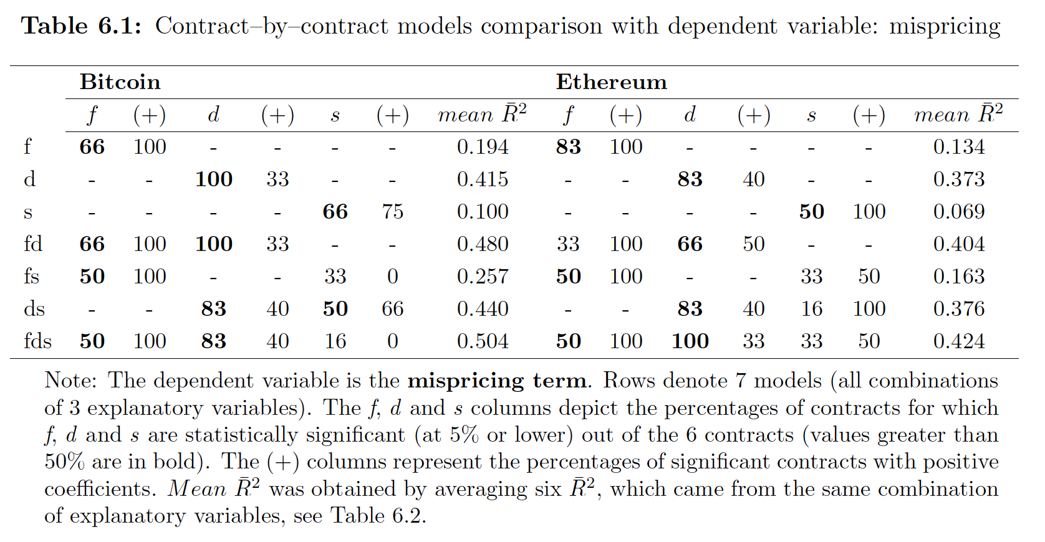
Results and evaluation (contract-by-contract analysis)
Notes:
Looking at Table 6.1, which was created by aggregating information from Table 6.2, the choice of the most optimal model is not straightforward.
Should we merely choose based on the highest average of adjusted R2, we would select the fds model for both Bitcoin and Ethereum as the mean adjusted R2 is 50.4% and 42.4% respectively.
Nevertheless, for both of these assets, the estimated coefficient for s is not statistically significant for most of the contracts (only 16% for Bitcoin and 33% for Ethereum).
The fd model is more promising as the mean adjusted R2 for both Bitcoin and Ethereum drops only slightly, suggesting that s was not an important explanatory variable. The issue with the fd model is that d does not have the expected sign for the majority of the contracts. Out of all significant contracts, the positive sign turned out to be estimated only 33% of the time for Bitcoin and 50% for Ethereum.
We hypothesized that the sign would be positive for most of the contracts as with more popularity, recognition and market adoption, the mispricing (and basis) should be increasing towards zero. Unless there is an explanation for negative d, which we have missed, this leaves us with the f model, whose mean adjusted R2 is 19.4% and 13.4% for Bitcoin and Ethereum respectively. Not all contracts showed f to be statistically significant, but it was the majority (66% and 83%). Moreover, all significant coefficients have the expected sign.
Taking all this into consideration, we choose the f model to be the final model for both
Bitcoin and Ethereum, though, for Ethereum, the fd model could be good as well.

Slide 21
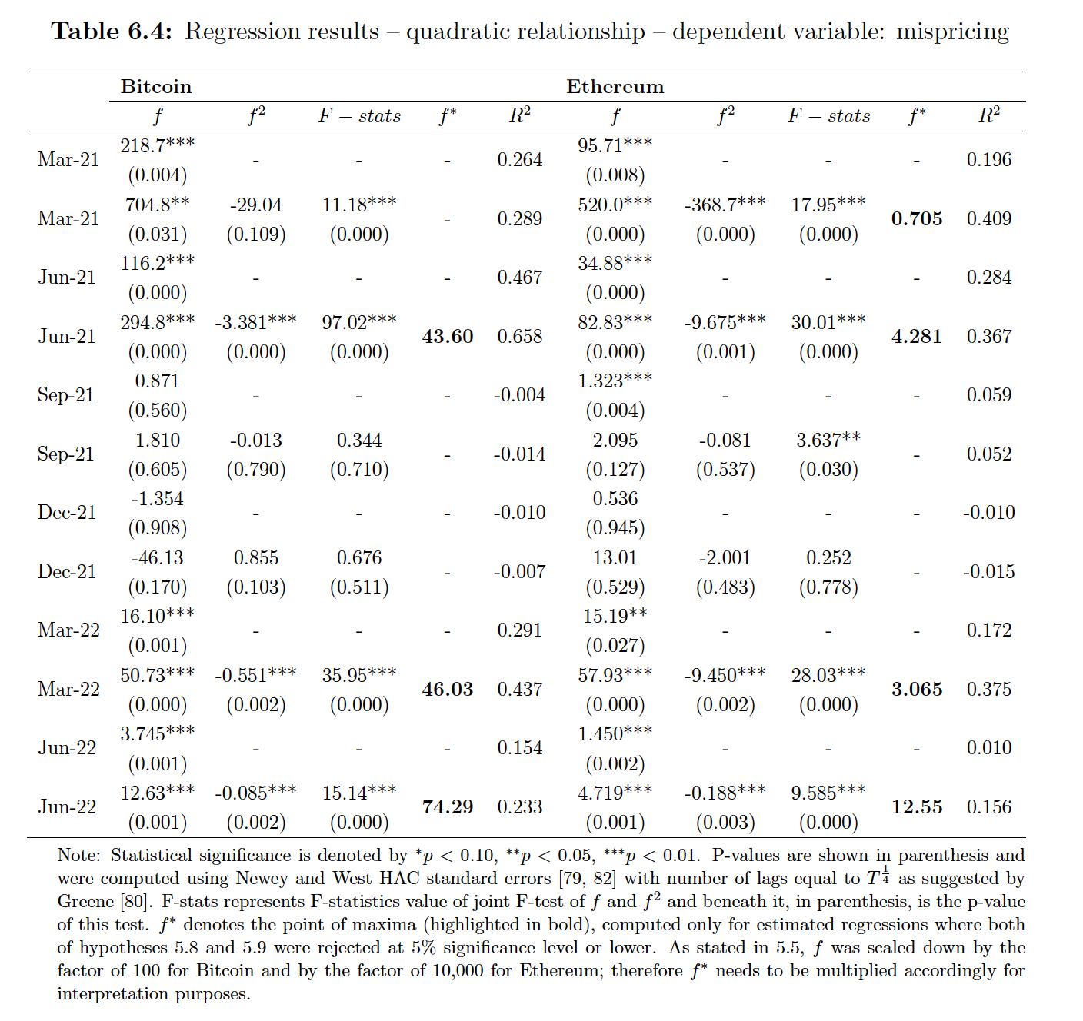
Results and evaluation (quadratic form specification)
Notes:
BTC:
Jun–21 contract
has the daily futures trading volume higher than 4,360 (its point of maxima) on 2 different
days: 19.5.2021 where the trading volume reached 7,145 trades, and on 10.6.2021
where the trading volume reached 5,497 trades.
The point of maxima for Mar–22 contract is 4,603, which was exceeded on 7 different
days: 22.1.2022, 24.1.2022, 10.2.2022, 21.2.2022, 24.2.2022, 28.2.2022 and 16.3.2022.
The highest trading volume for this contract was recorded on 24.2.2022 (7,694).
The point of maxima for Jun-22 contract is 7,429 traded futures. This point was exceeded
on 5 different days, all close to expiration date: 13.6.2022, 14.6.2022, 15.6.2022,
18.6.2022 and 19.6.2022. The highest trading volume of 11,581 was recorded on
14.6.2022.
ETH:
Looking at Ethereum futures datasets, we can see some evidence of Ethereum futures
manipulation as well. The Mar–21 contract’s point of maximum is at 7,050 with
9 days going beyond this value: 4.2.2021, 22.2.2021, 23.2.2021, 8.3.20201, 10.3.2021
to 13.3.2021 and 15.3.2021. The highest trading volume of 11,120 was recorded on
23.2.2021.
Jun–21 contract, with the point of maxima equal to 42,810, contains 2 days above
this value: 19.5.2021 (67,250) and 22.6.2021 (50,710).
Mar–22 contract has its point of maxima equal to 30,650 and 7 days which go beyond
this number: 7.1.2022, 21.1.2022, 22.1.2022, 24.1.2022, 4.2.2022, 21.2.2022 and
24.2.2022. The highest trading volume was reached on 24.2.2022 (55,180).
Jun–22 contract has 5 days that are above the point of maxima of 125,500: 13.6.2022
to 15.6.2022, 18.6.2022 and

Slide 22
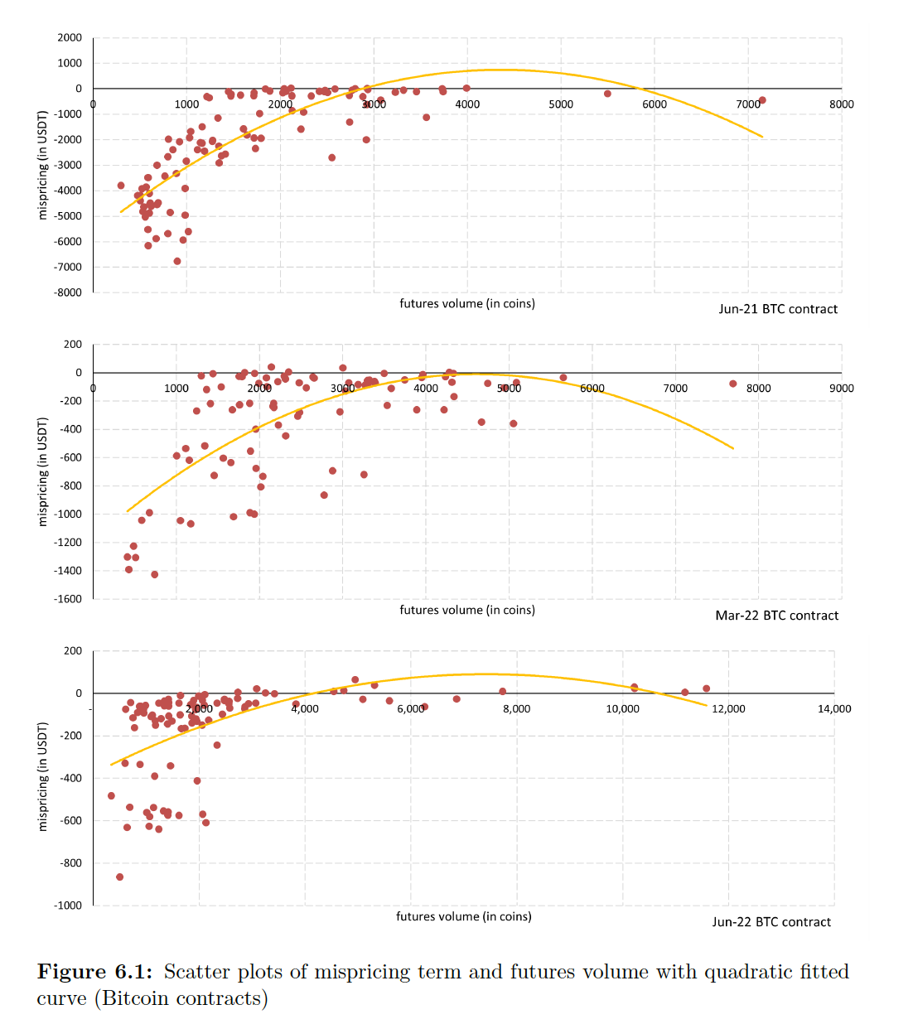

Slide 23
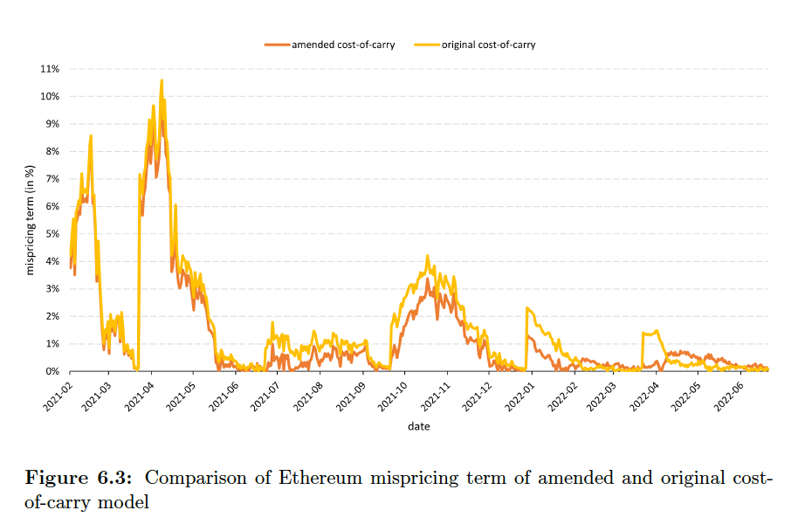
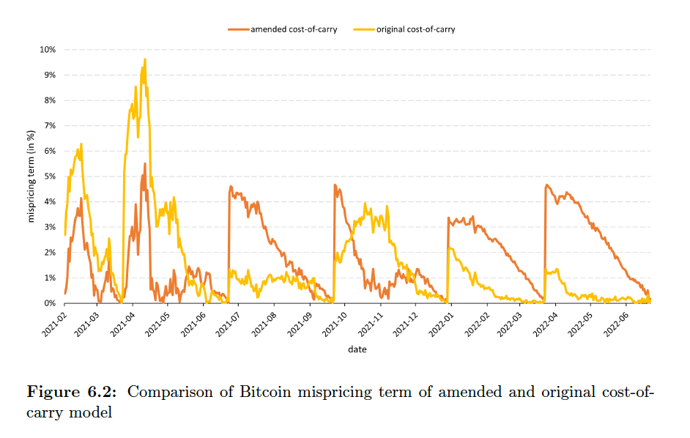
Results and evaluation (cost-of-carry model)

Slide 24
Demonstration
Showing how results for the quadratic regression model were obtained in R (includes HAC standard errors).

Slide 25
Q&A
Notes:
Will’s email:
In terms of Q&A you should find the questions straight down the line; be prepared to explain for example the primary technical challenges you overcame, what you would do differently if you started the project afresh, what feature you feel would be most urgent to implement if you had extra time, how your results compare with the state of the art in the literature, to explore the demo further and so on. We are unlikely to spend much examining your code base during the presentation itself but you should be prepared to show it and we may ask you to show and explain particular bits of code that are of particular interest.

Slide 26
Possible question 1: What you would do differently if you started the project afresh?
I spent considerable amount of time on researching the risk-free rate (chapter 1: Literature review, section: Evolution of risk-free rate).
After running the regressions with different risk-free rate, I found out that the differences in different risk-free rates are negligible for the the type of analysis done in this paper.
I would simply use the 4-week or 3-month US T-bill.
Notes:
Possible questions

Slide 27
Possible question 2: Explain primary technical challenges you overcame.
Binance API, documentation, articles
Binance 4 different types of futures contracts not well documented
Binance: Insurance fund balance issues 23/05/2021/01:00

Slide 28

Possible question 3: How your results compare with the state of the art in the literature?
In general, the regression results from our contract–by–contract analysis are consistent with Hattori et al. [1] and De Blasis et al. [2], providing further evidence that futures volume $(f)$ is the most important explanatory variable. This differs from results by Matsui et al. [21], who found futures volume not be to statistically significant for most Bitcoin contracts (in the mvo model, futures volume was statistically significant in 17% of all contracts).

Slide 29
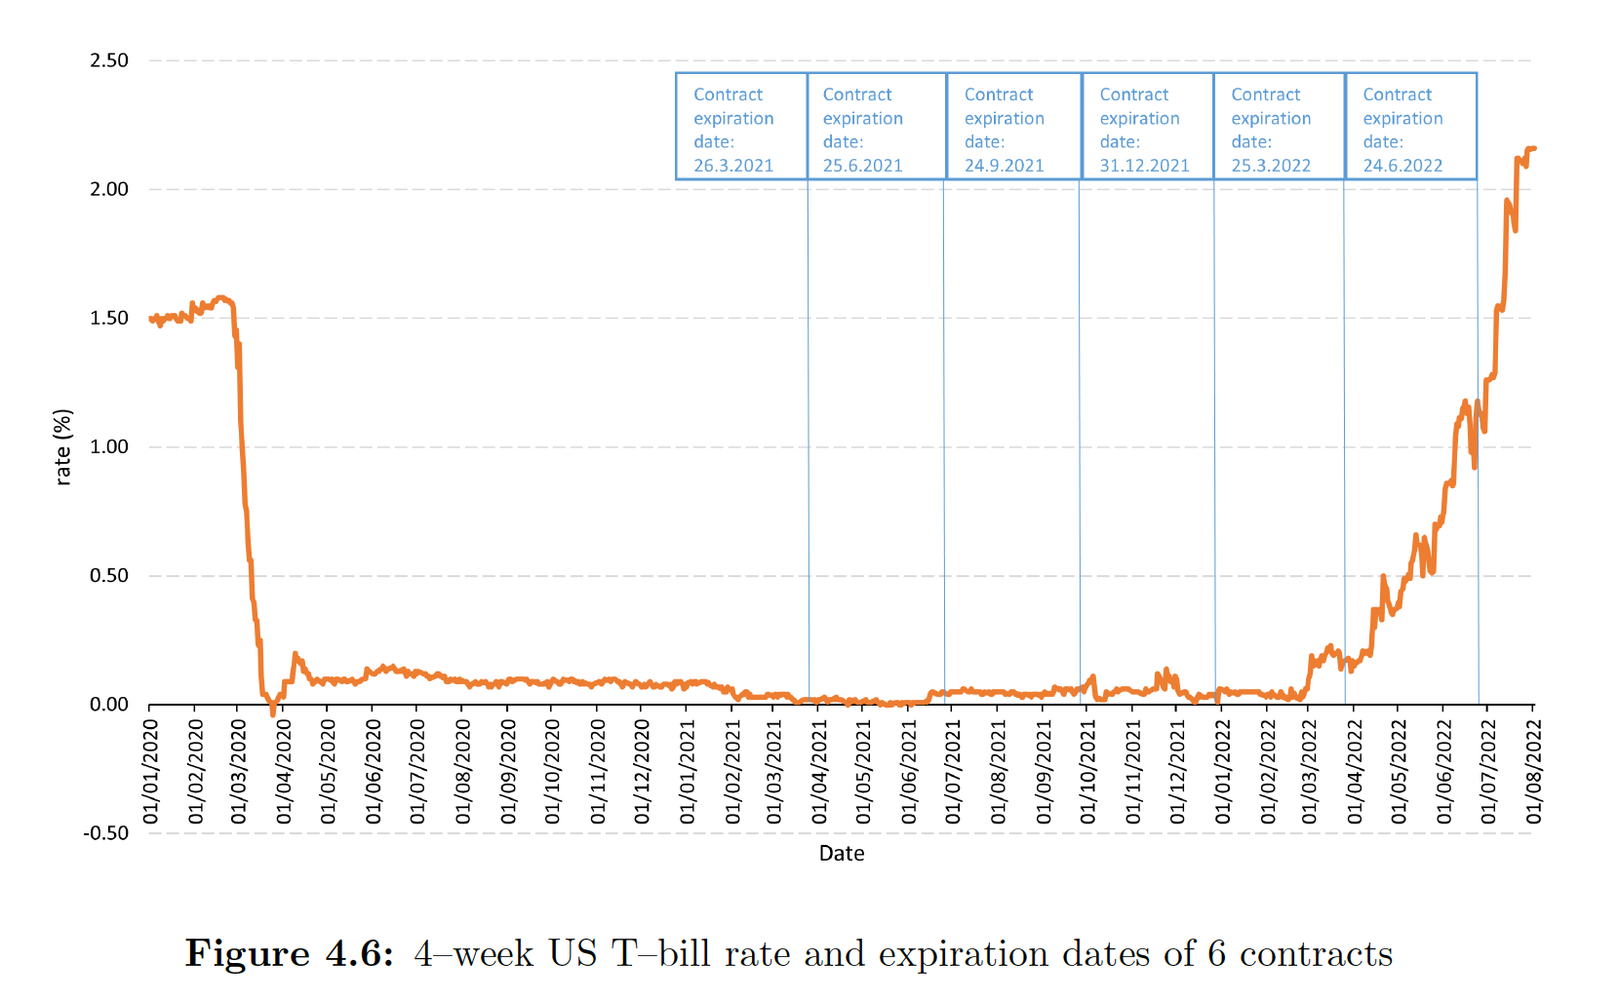
Possible question 4: Why are the results the same for the two dependent variables (mispricing term and basis)?

